Slide 1


Advanced Business Analytics and Project Management
OPIM 5770
Final Presentation
Team 2
Incident Response Management System

Slide 2






Meet the Team
ASHIMA GUPTA
AVIRAL GAUR
BENJAMIN HOOD
MAHIMA AGRAWAL
NAMITA SINGH
SAI TEJA PAMARTHI

Slide 3
Agenda
Business Problem
Business Objective
Dataset Description
Data Preprocessing
Data Correlation
Data Insights
Objective 1
Objective 2
Q & A

Slide 4

Business Problem
Managing high ticket volumes is critical for any organization.
Cigna receives very high number of incident tickets (~ 450/hr.) with Moderate/High priority tags.
Huge number of tickets marked high priority are False positives and impacts the quality of service.
Manual allocation of tickets to technology teams result in wastage of time and resources.
Lack of automation for Incident Triage.

Slide 5

Business Objective
Developing a model to predict the Top 3 technology teams to be engaged to improve routing accuracy and time to engage.
Developing a model to predict the probability of an incident becoming a managed incident to improve real time prioritization.

Slide 6
Dataset Description
Dataset used in this Project is received from CIGNA for the purpose of analysis and solving Business Problems indicated.
Dataset contains 41 columns and ~320k records
32 categorical and 9 continuous variables
29 Before and 11 After variables and 1 variable in Datetime format changing with system update
Target variable for Objective 1 is “ASSIGNMENT_GROUP”
Target variable for Objective 2 is “PRIORITY”

Slide 7
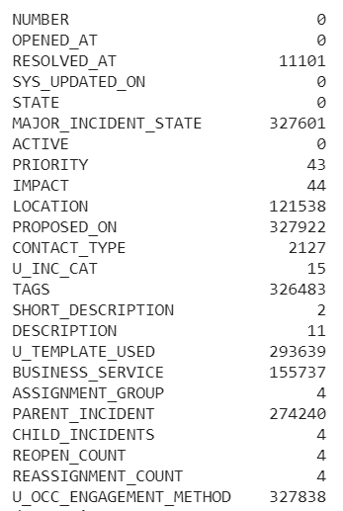
Data Preprocessing
Dropping all “After” variables as they are populated after the incident is managed.
Dropping variables with high number of null values “U_OCC_ENGAGEMENT_METHOD”, “TAGS”, “U_TEMPLATE_USED” and DATETIME variables as they will not contribute to the Modeling
Merging “SHORT_DESCRIPTION” and “DESCRIPTION” column for Text mining
**Null values count

Slide 8
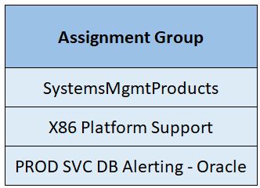
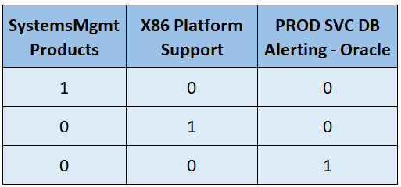
Data Preprocessing
Steps involving Stop word removal, Tokenization, and Stemming on the “DESCRIPTION” column.
Assignment_Group - One Hot Encoding
Data
Pre-Processing
Stop word Removal
Tokenization
Stemming
TFIDF

Slide 9
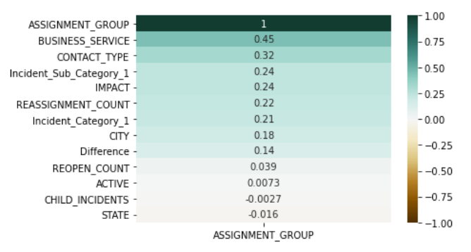
Data Correlation
Correlation graph of “ASSIGNMENT_GROUP” with other variables used in Modeling

Slide 10
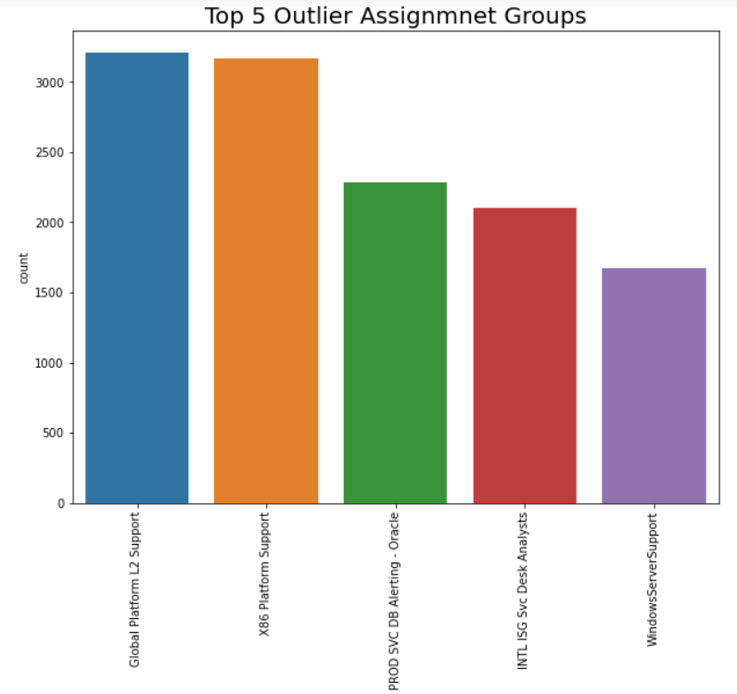
Data Insights
49% of the incidents were resolved within 100 minutes
13% of the incidents have higher average resolution time of 17550 mins
Average time to solve a Managed Incident is 1200 minutes (excluding outliers)

Slide 11
Objective 1
Developing a model to predict the Top 3 technology teams to be engaged to improve routing accuracy and time to engage.

Slide 12
Objective 1 - Modeling
Target Variable is “ASSIGNMENT GROUP”
Performing classification using Machine Learning algorithms to predict the teams to which a particular incident should be routed to be resolved
Four Major types of Classification tasks
Classification
Binary
Multi-Class
Multi-Label
Imbalanced

Slide 13
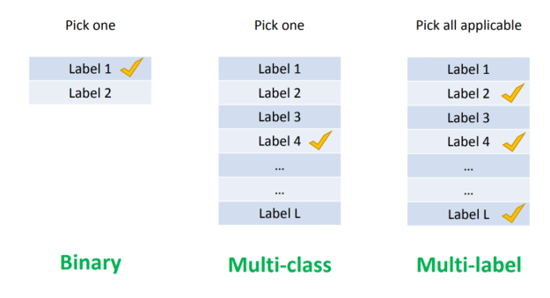
Objective 1 – Multi Label Classification
For our purpose, we are performing Multi –label Classification
It is where more than one classes can be present in a single group
Solving Multi-label Classification Problems
Problem Transformation
Adapted Algorithm
Ensemble approaches

Slide 14
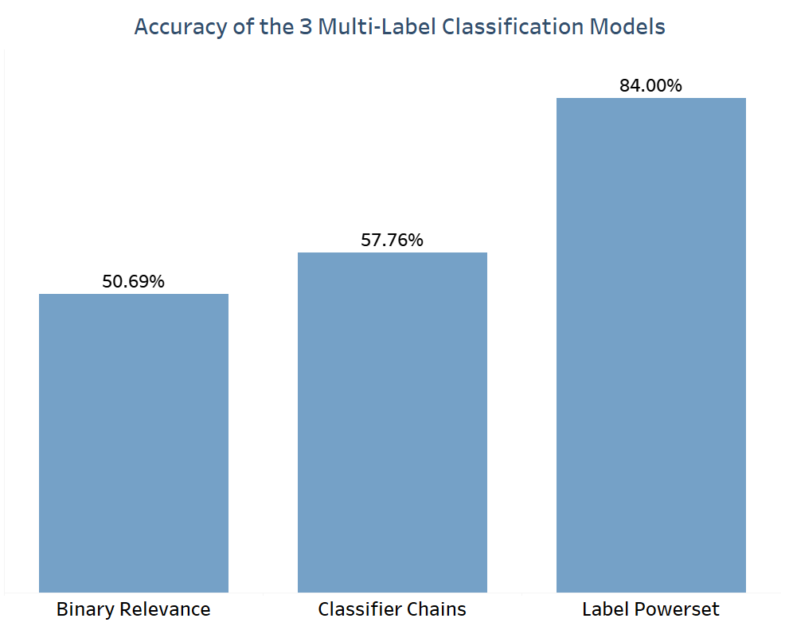
Objective 1 – Accuracy Metrics
Ran three Multi Label Classification models - Binary Relevance, Classifier Chains, *Label Powerset
Achieved the highest accuracy with Label Powerset algorithm (~84%)
The other two models have accuracy of 51% and 58%
*Label Powerset – Transform the problem into a multi-class problem with 1 multi-class classifier trained on all unique label combinations found in the training

Slide 15
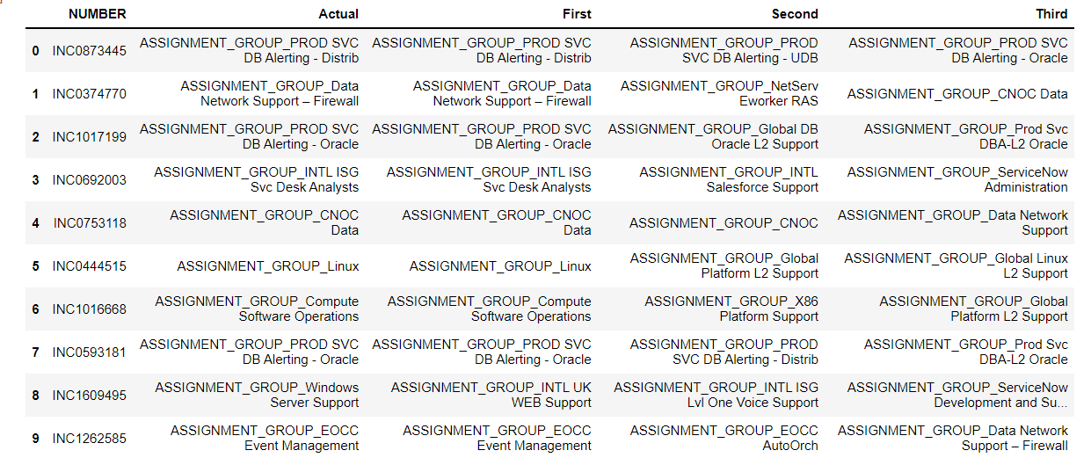
Objective 1 – Accuracy Metrics
95%
Top three teams based on probability
We can update incidents based on unique identifier “Number”
Achieved accuracy of 95% till third level prediction
93%
84%

Slide 16
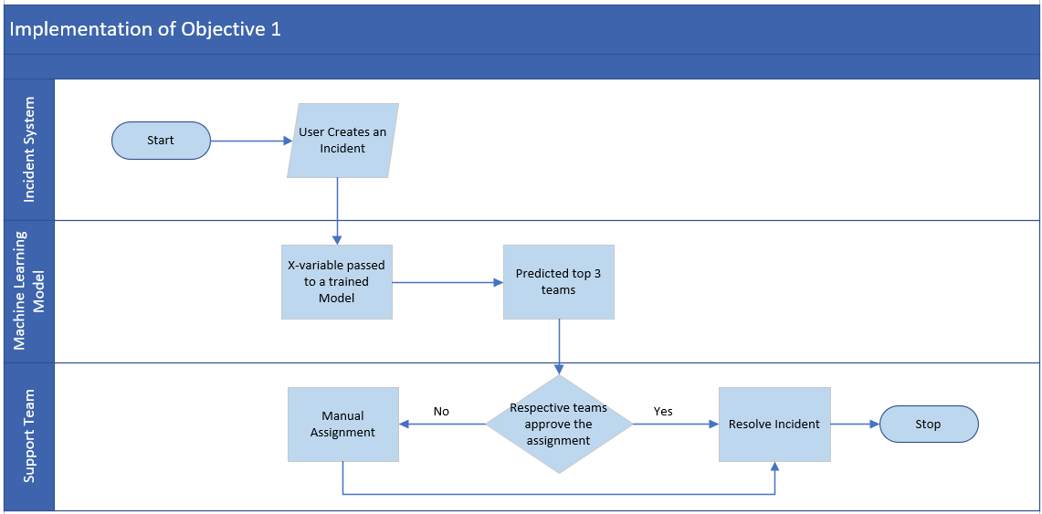
Objective 1 - Implementation
Independent variables – Business service, Contact type, Description and Short Description

Slide 17
Objective 1 - Cost Model
Parameters & Calculation:
Average re-assignment count (x) = 1.5
Average operation engineer cost (y) = $ 35
Average time consumed during re-assignment (p) = 15 mins (0.25 hr)
Reduction in Misclassified incidents (n) = 72
Cost Saved per hour = x * y * p * n = $ 945

Slide 18
Objective 2
Developing a model to predict the probability of an incident becoming a managed incident to improve real time prioritization.

Slide 19
Objective 2 – Modeling
Target Variable : PRIORITY (Divided into M1, M2, M3 & 2, 3, 4 classes)
M1,M2- Null & Accepted Incident state & M3- All Incident State
Conversion to Binary categorical variable (M1,M2,M3 as 1 and 2,3,4 as 0)
Sampling techniques applied
Sampling
Stratified Data Partitioning (Under sampling)
SMOTE
(Over sampling)

Slide 20
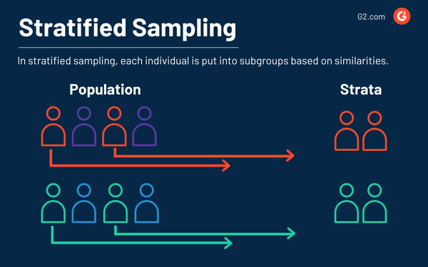
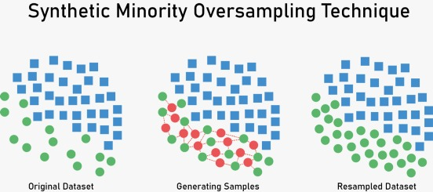
Objective 2 – Sampling Techniques
*Stratified Data Partitioning – Training (60%) Validation (20%) Test (20%)
Synthetic Minority Oversampling Technique/SMOTE – Training (50%) Validation (20%) Test (30%)
*https://community.jmp.com/t5/JMP-Add-Ins/Stratified-Data-Partitioning-with-balancing-options-add-in/ta-p/22001

Slide 21
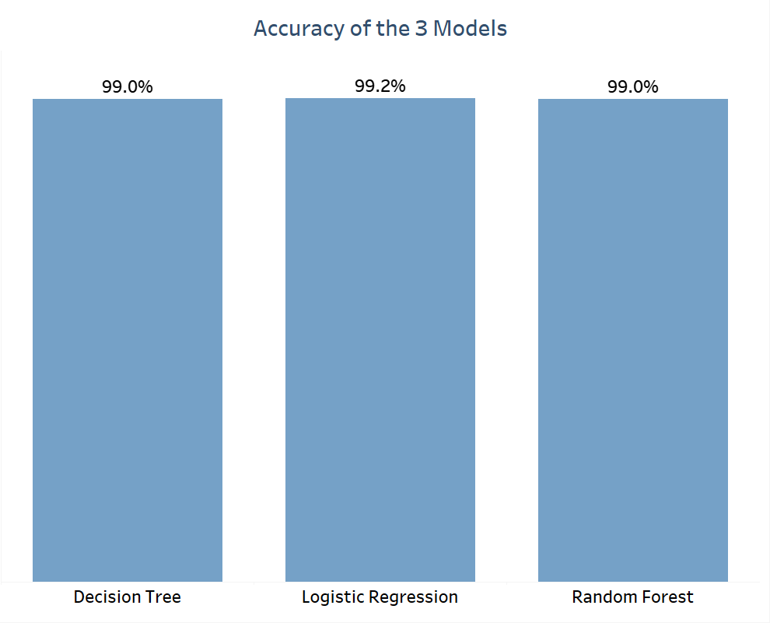
Objective 2 – Accuracy Metrics
Ran multiple models to predict the best fit
Choosing Decision tree as the Best Model :
High accuracy (99%)
Interpretability

Slide 22
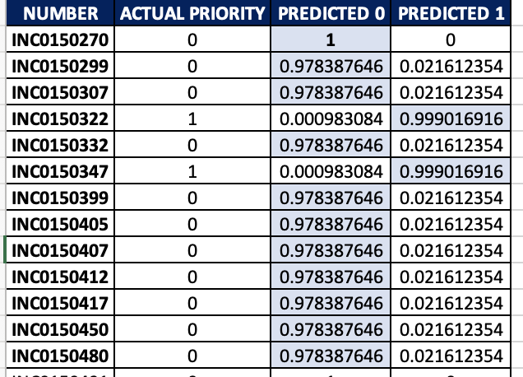
Objective 2 – Probability Output
Predicted the Probability of an incident becoming a managed incident
Accuracy 99 % as stated already with model by default threshold i.e., 0.3
Results vary when threshold changes :
Threshold – 0.6
Accuracy – 85%

Slide 23
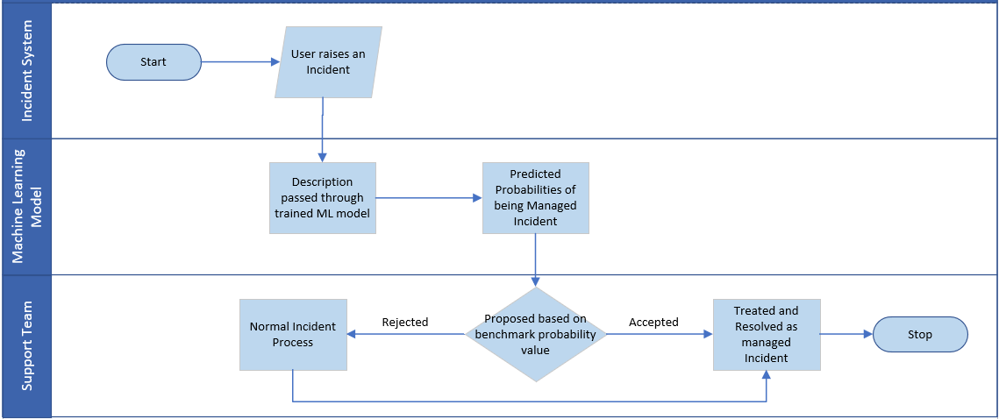
Objective 2 - Implementation
Independent variables – Description and Short Description

Slide 24
Objective 2 – Advantages
The automation for the process of proposing Managed Incident review would help in:
Minimize the duration of an outage each quarter by reacting to the incidents faster.
Maintaining high quality of customer experience by minimizing the impact to “Access to Care”.
Modernizing existing monitoring and telemetry to drive down outage durations.

Slide 25

Thank You!
We are open for Q & A

Slide 26
Appendix – References links
1. (Jcharis, 2020) (Jcharis, Python Machine Learning, 2020)
https://github.com/Jcharis/Python-Machine-Learning/blob/master/Multi_Label_Text_Classification_with_Skmultilearn/Multi-Label%20Classification%20with%20Python%20and%20Scikit-Multilearn-.ipynb
2. (Brady, 2014)
https://community.jmp.com/t5/JMP-Add-Ins/Stratified-Data-Partitioning-with-balancing-options-add-in/ta-p/22001

Slide 27
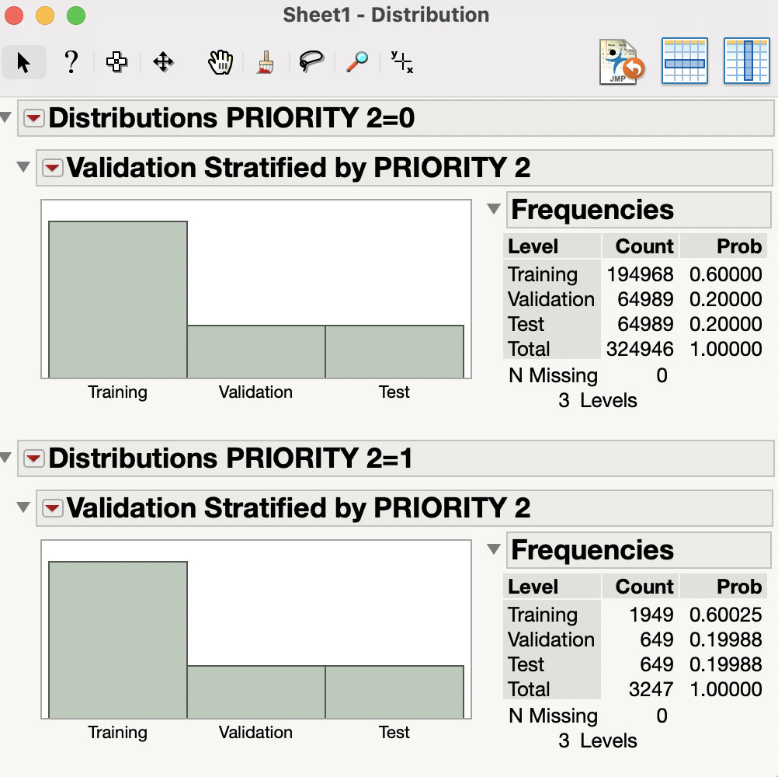
Appendix – Sampling Split

Slide 28
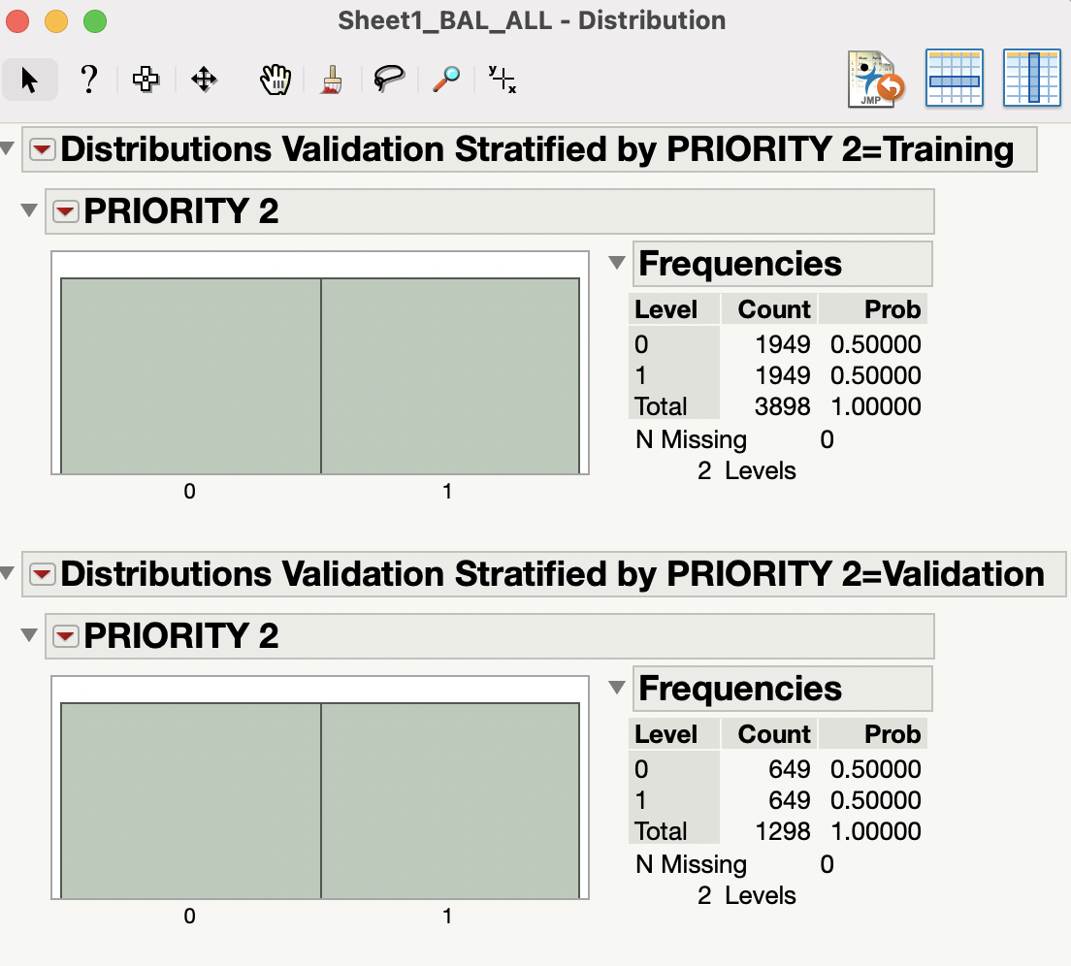
Appendix – Validation Distribution

Slide 29
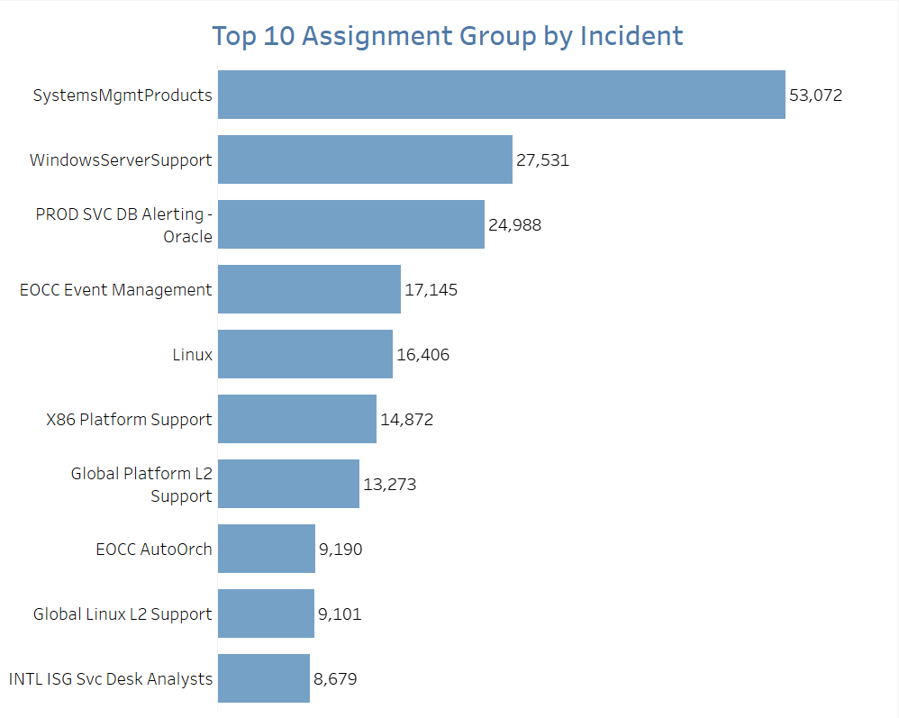
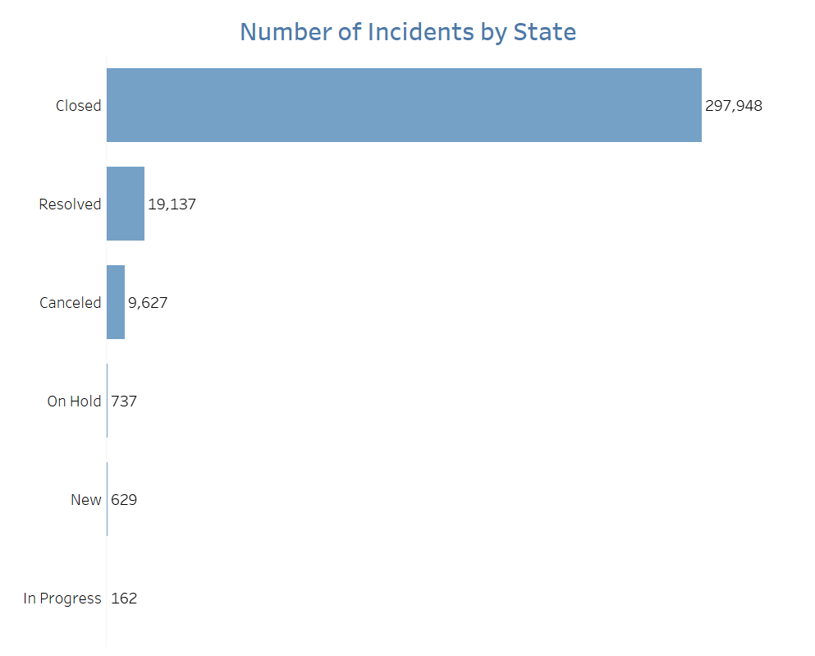
Appendix - EDA

Slide 30
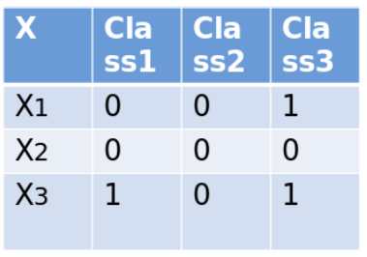
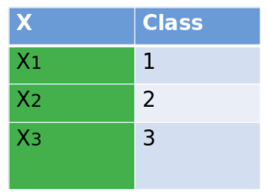
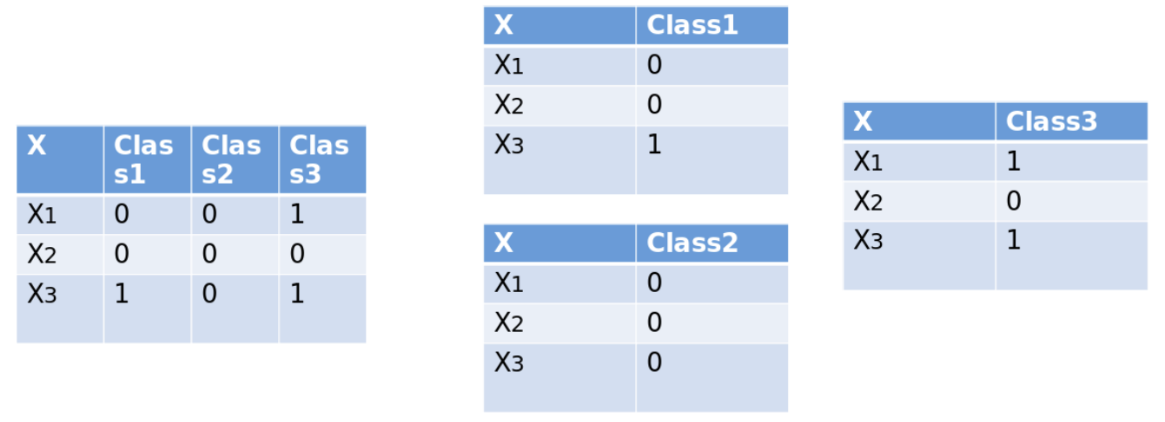
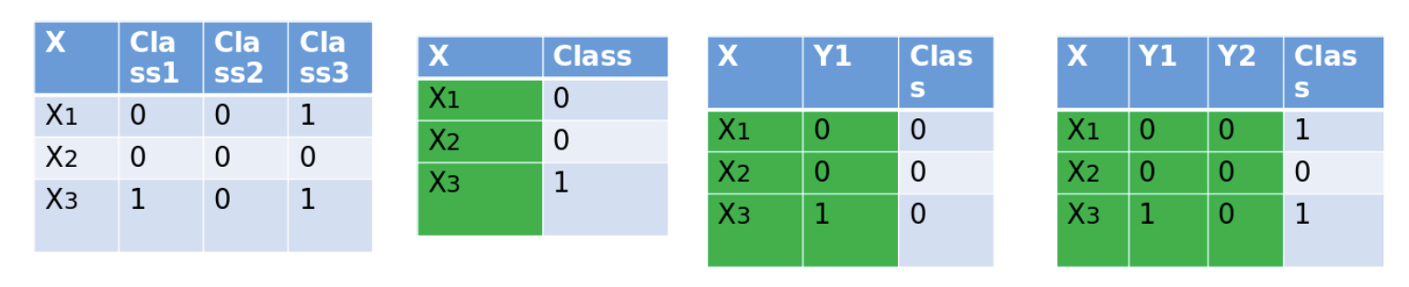
Appendix - Multi Label Classification
Label Powerset
Binary Relevance
Classifier Chains

Slide 31
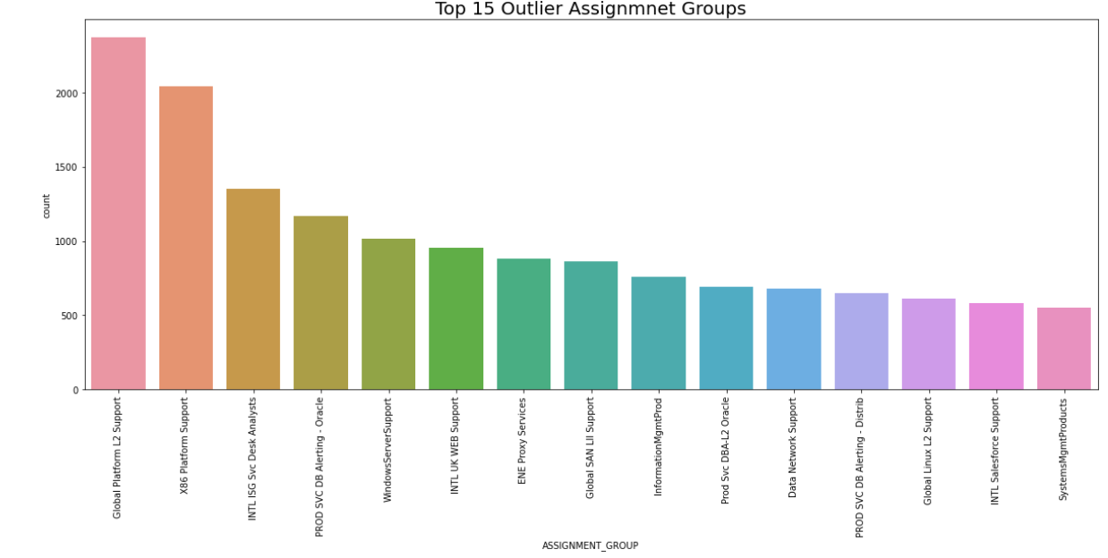
Appendix

Slide 32
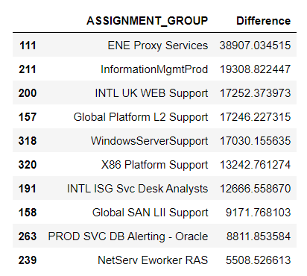
Appendix – Average resolution time outliers

Slide 33
Appendix – Cost Model Calculation
Model 1 calculations:
Avg reassignment count from the dataset: 1.5
Avg time consumed during reassignment(already stated above) : 15 mins(0.25 hrs)
Avg cost for operations engineer: $35
Number of hourly incidents: 450
BEFORE
% of misclassified/reassigned incidents from the actual dataset: 30% ( Reassignment count with 0's and blanks : 235716 and >=1: 92000)
hourly misclassified incidents: 135 (450*0.3)
Cost_Before: 1.5*0.25*35*135 = $1771
AFTER
% of misclassified/reassigned incidents after modeling: 14%
hourly misclassified incidents: 63 (450*0.14)
Cost_After: 1.5*0.25*35*63 = $826
Savings = Cost_Before - Cost_After : $1771 - $826 = $945 per hour

